Slide 1
System Module
A model for PoC
Anshu Kumar Kansal
-Sr. Research Scientist

Slide 2
Design Blocks :
UI
(User interface)
C:/Users/imans/PycharmProjects/Test_ex/Decorator.py
Business User

Slide 3
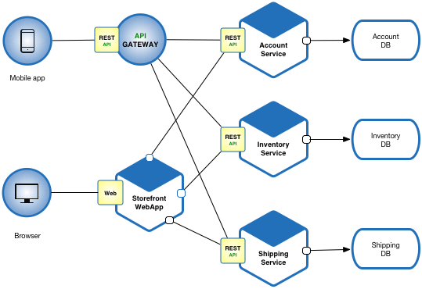
Architecture:
Account DB :
1. mongo
2. Cassandra
3. Rmdb (sql basis)
4. Cloud db (amazon cloud service)

Slide 4
Program flow :
Unit Test
Functional Test
Acceptance Test
Integration Test
User Acceptance Test
Performance Test
Production
Run on
build machine
Deploy on build machine
User test by giving sample test
Connect ui
with Database
Deploy on
UAT environment
Final prod. start
Deploy on
Performance
environment

Slide 5
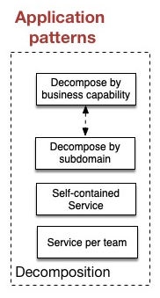
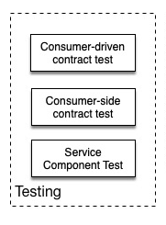
PATTERNS:
Application pattern: it is
followed by decomposition
2. Testing pattern: completely
independent pattern
-> testing doesn’t include Unit
process
Tags:
--use-feature=2020-resolver
(only to update modules)

Slide 6
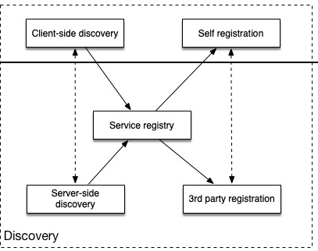
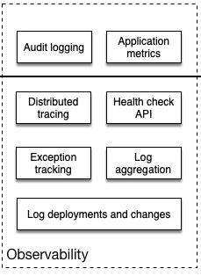
….continue

Slide 7
Netflix eureka
WerkZeug: A WSGI web application , basically a combination of several wsgi application build in wrapper of web.
Jinja : A templating language, fast and secure with an optional sandboxed template execution environment.
SimpleJson : a format that execute a key and value.
Html : a web scrapper that to link a server. (default : https://localhost:8080/content )
Javadoc : reference to interface and classes that has nothing to do with their implementation and development. It doesn’t resolve code integration.
Application Pattern : this architect is followed by decomposition.

Slide 8
Web layer Objective
1. Make the packaging adaptable to sling tool.
2. Cassandra in integration to sling though web layer.
3. Mongo integration no more needed.
4. Data formation in separate field elements .
5. Exception handling in web layer itself
6. DAO support to Cassandra in SQL manner
7. Service management loosely coupled architecture
8. Data integration with Cassandra database
9. Field elements will have key-value structure.

Slide 9
Software development :
Business user screen
UI USER
Apache servlet repositpry
SLING layer (default port 8080)
Mongodb + cassandra
Database layer
Initialization test
POSTMAN

Slide 10
Benefits :
Services can written and deploy independently i.e. account service, database service
Separate service don’t affect the agility of each other services.
Database also can independently build according to the requirement.
Field elements formation in the database server.
Data Integration with cql database submission timed output.
Total process time of data transfer has been calculated. ( front user end to back developer end )
Drawbacks :
Too many services makes it a complex architecture.
Data consistency can be a challenge. Embeded new service can be a lot . Whole creation process have to be repeated again.
race eventual consistency where possible.

Slide 11


